Slide 1


Human Evaluation of a Robot’s Pointing Capability
Or, How I Learned to Stop Worrying About the Robot and Love the Laser
Bryan MacGavin and Jen Tennison

Slide 2
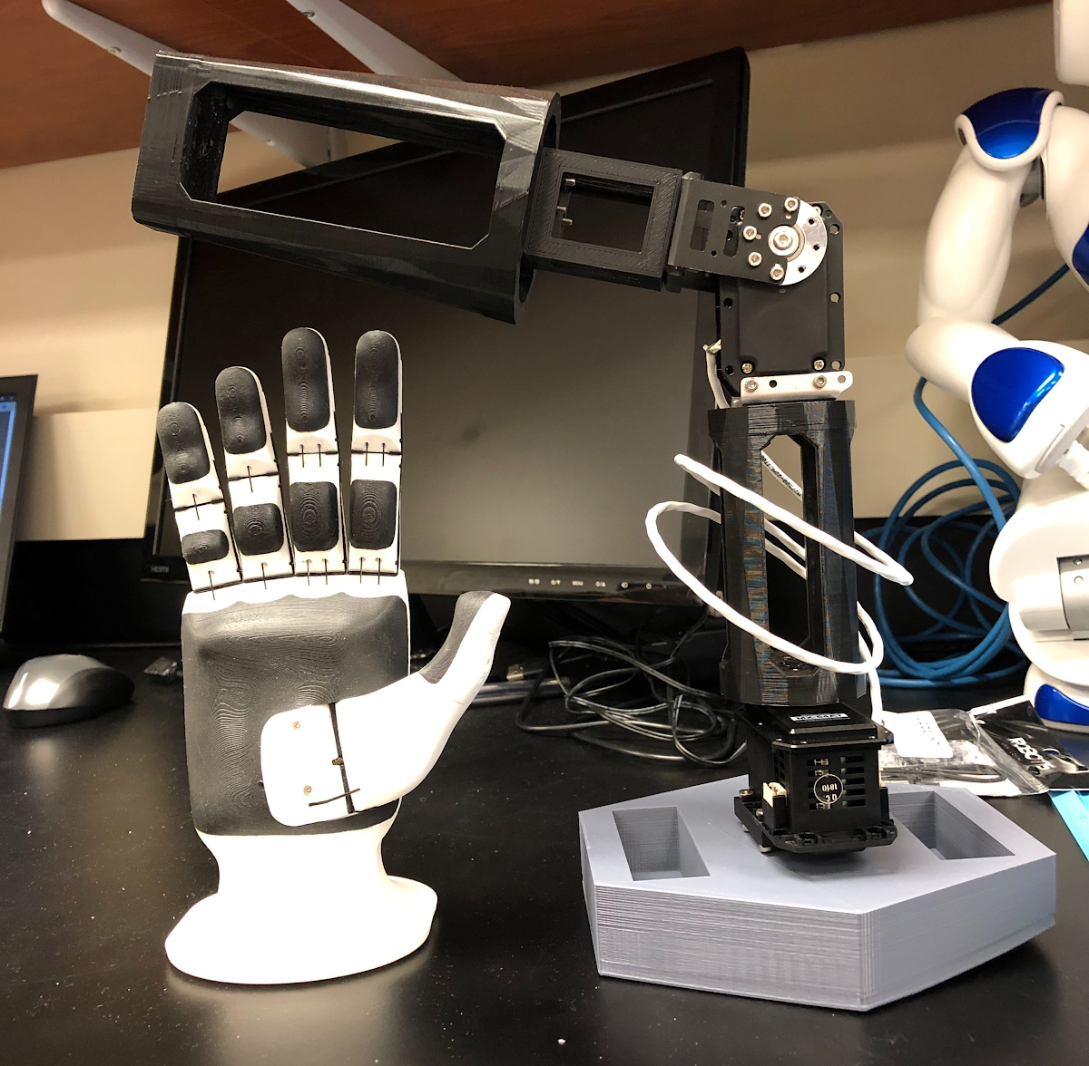
Friendship Ended with Brunel Hand 2.0
Now robot arm
is my
best friend

Slide 3
Motivating Question
How precisely… →
…can humans determine →
…where a robot is pointing?

Slide 4



HRI Social Building Blocks
Deixis
Kinesics
Where is the robot arm pointing?
Goal: Facilitate directional pointing to human interactors
End effector: Inflatable hand, pointer finger outstretched
Augment: Laser attached to arm underneath pointer finger to convey precise pointing locations
Where does the robot arm need to be?
Goal: Arm must move seamlessly to each region or location. Joint trajectories must be exact every time.
Implementation: ROS and python
Testing: Simulation, ROS sliders, and published messages

Slide 5

Previous Work
Robotic arms can assist and direct elderly in a home-like setting^{[1]}
Speech, speech + gesture + congruency, and speech + gesture + incongruency can affect human understanding of objects pointed at^{[2]}
The effect of robotic presence on how requests and personal space are perceived^{[3]}
Robotic visual recognition of human pointing gestures for human-robot interactions^{[4]}

Slide 6
Study Design

Slide 7

Research Question
How precisely can humans determine where a robot is pointing?
2 Studies Planned
Identifying a region being pointed at
Identifying a point being pointed at

Slide 8


Study Procedure
Study 1: Region Identification
Participant stands directly behind arm.
Robot “naturally” points to 1 of 9 regions on a whiteboard.
Sometimes, arm does not go directly to the point or readjusts its position
Participants decide what region the robot is pointing.
Participants are asked how confident they are in their response.
A laser attached to the arm reveals to the participant precisely what position the robot was pointing.
Participant's correctness is recorded.
Study 2: Point Identification
Participant stands directly behind arm.
Robot points to 1 of 3 targets on a whiteboard.
A participant marks where they think the robot is pointing on whiteboard.
A laser attached to the arm reveals to the participant precisely what position the robot was pointing.
Deviation from participant’s point to robot’s point is calculated.

Slide 9
Variables Measured
Study 1
Study 2
Participant’s Correctness
Interpreting where the robot is pointing
Participant’s Confidence
Rating their confidence in their chosen region
Godspeed Questionnaire
Rating confidence in and likeability of arm.
Deviation between points
How far away is the participant’s interpreted point from the robot’s actual point.

Slide 10
Why does this matter?
Identifying regions
Identifying precise points
We should be able to understand exactly what’s being pointed to
We should be confident in what’s being pointed to
Do humans need to feel confident in the robot’s ability to feel confident in knowing what’s being pointed to?
How accurate can we be in determining the position of the robot’s point?

Slide 11
Implementation

Slide 12
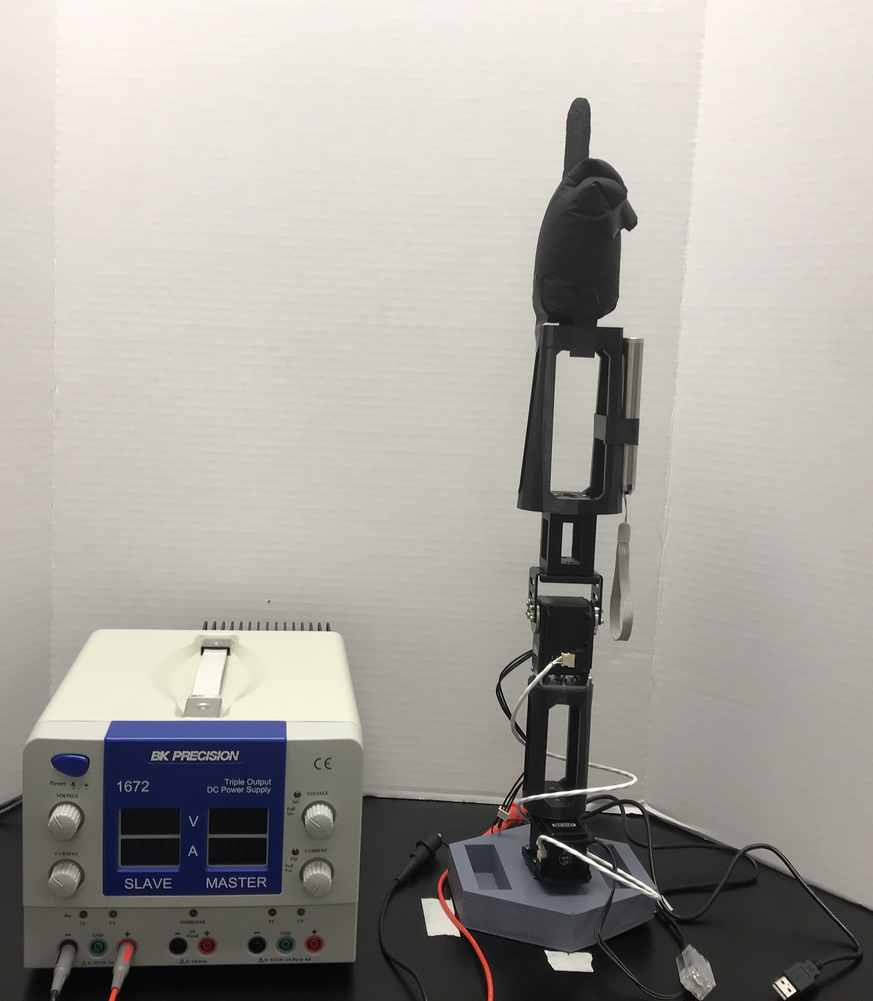
Pointing Hand
Power Supply (12 V)
Laser
Robotic Arm (2 DOF)

Slide 13
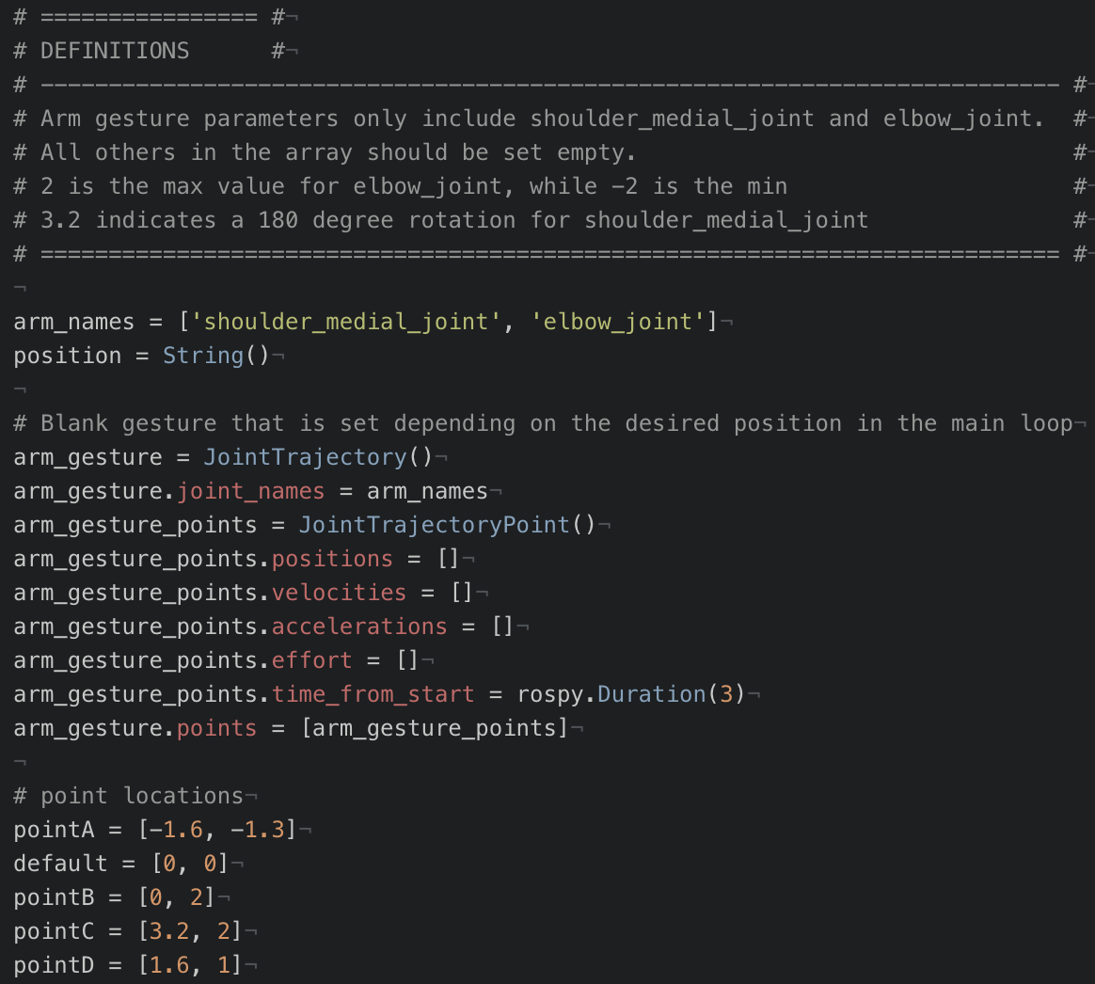
Variable Definitions:
One JointTrajectory variable (arm_gesture) is used to move all points.
Arm_gesture_points.positions is overwritten by each point location and depends on the message received from /arm_gestures channel.

Slide 14
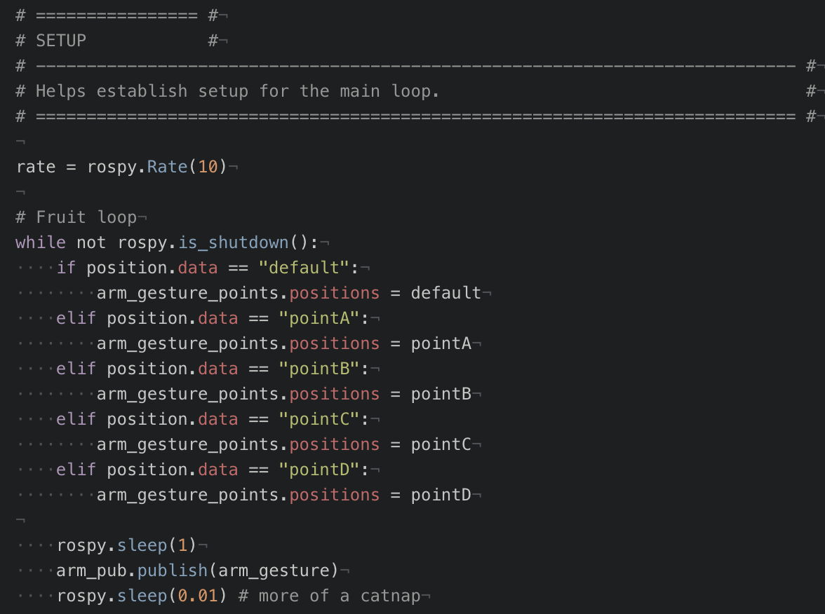
Functionality of Main Loop:
A command is published to /arm_gestures channel and is saved to position.data.
The position message is evaluated in the main loop.
arm_gesture points are set according to the message received.
arm_gesture trajectory is published to arm.

Slide 15
Challenges

Slide 16
Main Challenges
Unable to reach testing phase due to hardware and software challenges.
USB had to be reflashed with up-to-date libraries
A start-up routine had to be established to move arm
Error accumulation in arm trajectory movement had to be accounted for

Slide 17
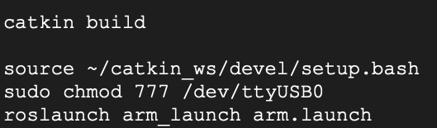
Determining the Start-up Routine
To interface with the arm and use the hardware successfully, a sequence of commands had to be run each time the USB loaded.
Builds catkin_ws packages
ROS setup
Connects to USB port
Enables hardware control

Slide 18
Error Accumulation in Arm Movement
In simulation, the arm moves to the expected location, every time.
In real world, the arm was not guaranteed to move to the expected location.
Arm had to be reset in order to move to its default position, straight up and down.
RQT Sliders and published messages to the arm channel were used to debug locations.

Slide 19
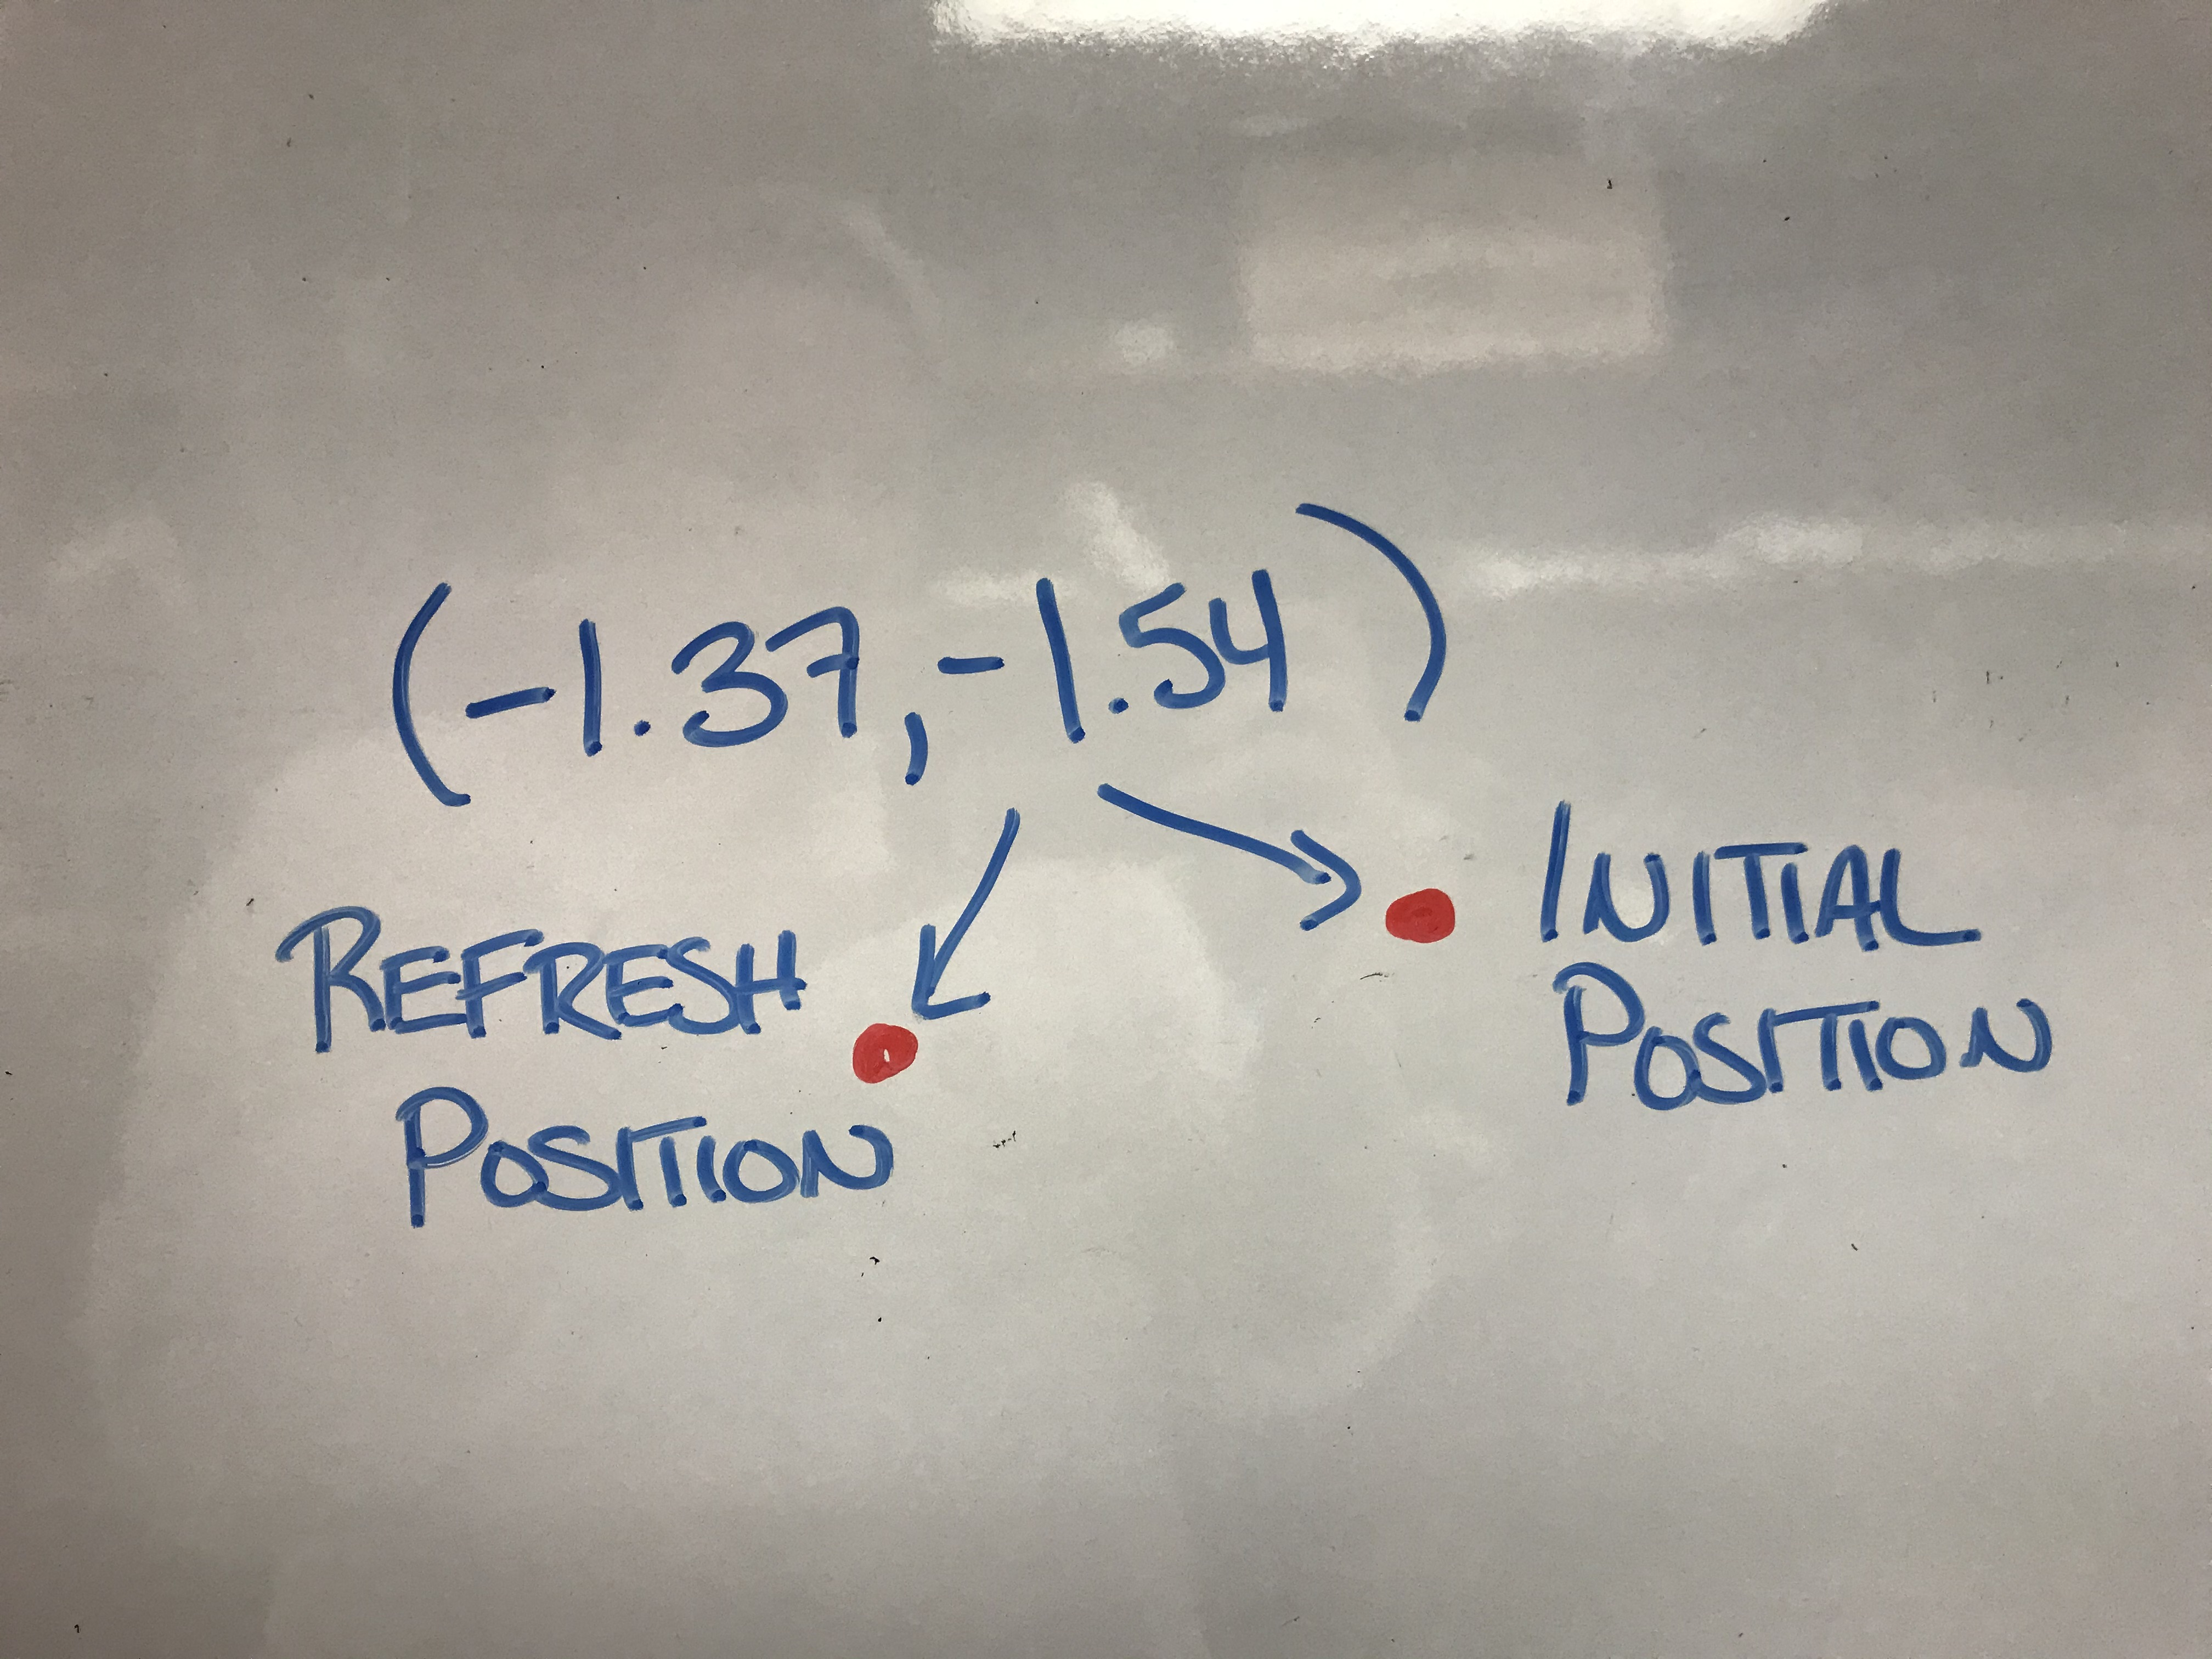
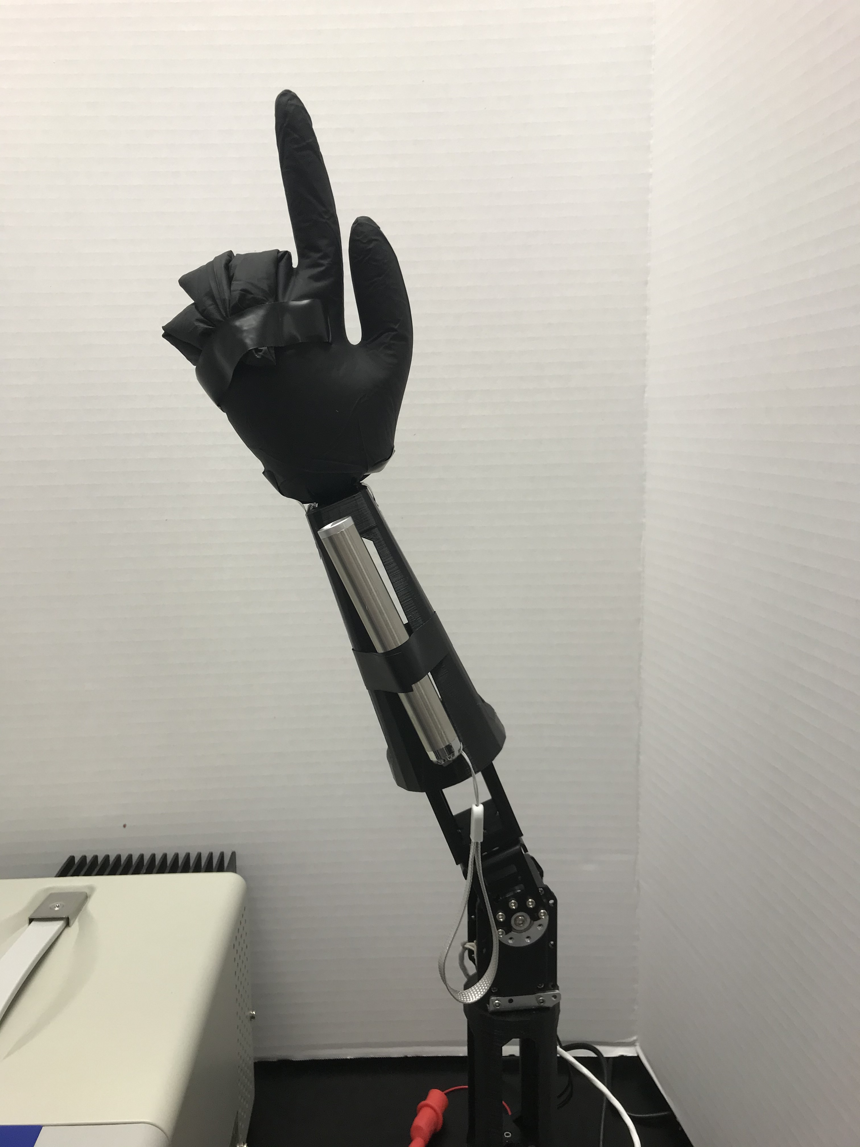
Does not fully straighten when called to default position.
Arm is also incorrectly rotated.
Repeated commands to the same point do not match in location.

Slide 20
Skills Learned
ROS and Python
How to interface python with the arm motors.
Structure of JointTrajectory and JointTrajectoryPoint
What can be left out and what needs to remain
Testing in a simulated environment
Hardware Setup
Connecting motors to power supply
Git without a GUI
Using terminal-based git commands for the first time
How to use VIM even though Emacs is the superior choice
The Beauty of Improvisation
“Something will work.”

Slide 21
References
D. Bassily, C. Georgoulas, J. Guettler, T. Linner and T. Bock, "Intuitive and Adaptive Robotic Arm Manipulation using the Leap Motion Controller," ISR/Robotik 2014; 41st International Symposium on Robotics, Munich, Germany, 2014, pp. 1-7.
Salem, M., Eyssel, F., Rohlfing, K. et al. Int J of Soc Robotics (2013) 5: 313. https://doi.org/10.1007/s12369-013-0196-9
W. A. Bainbridge, J. Hart, E. S. Kim and B. Scassellati, "The effect of presence on human-robot interaction," ROMAN 2008 - The 17th IEEE International Symposium on Robot and Human Interactive Communication, Munich, 2008, pp. 701-706. doi: 10.1109/ROMAN.2008.4600749
Kai Nickel, Rainer Stiefelhagen, “Visual recognition of pointing gestures for human–robot interaction,” Image and Vision Computing, Volume 25, Issue 12, 2007, Pages 1875-1884, ISSN 0262-8856, https://doi.org/10.1016/j.imavis.2005.12.020.

